Slide 1
VIRTUAL PIANO
Nish Dara, Thomas Franklin, Devon Grove, Blaine Weeks

Slide 2
The idea

Slide 3
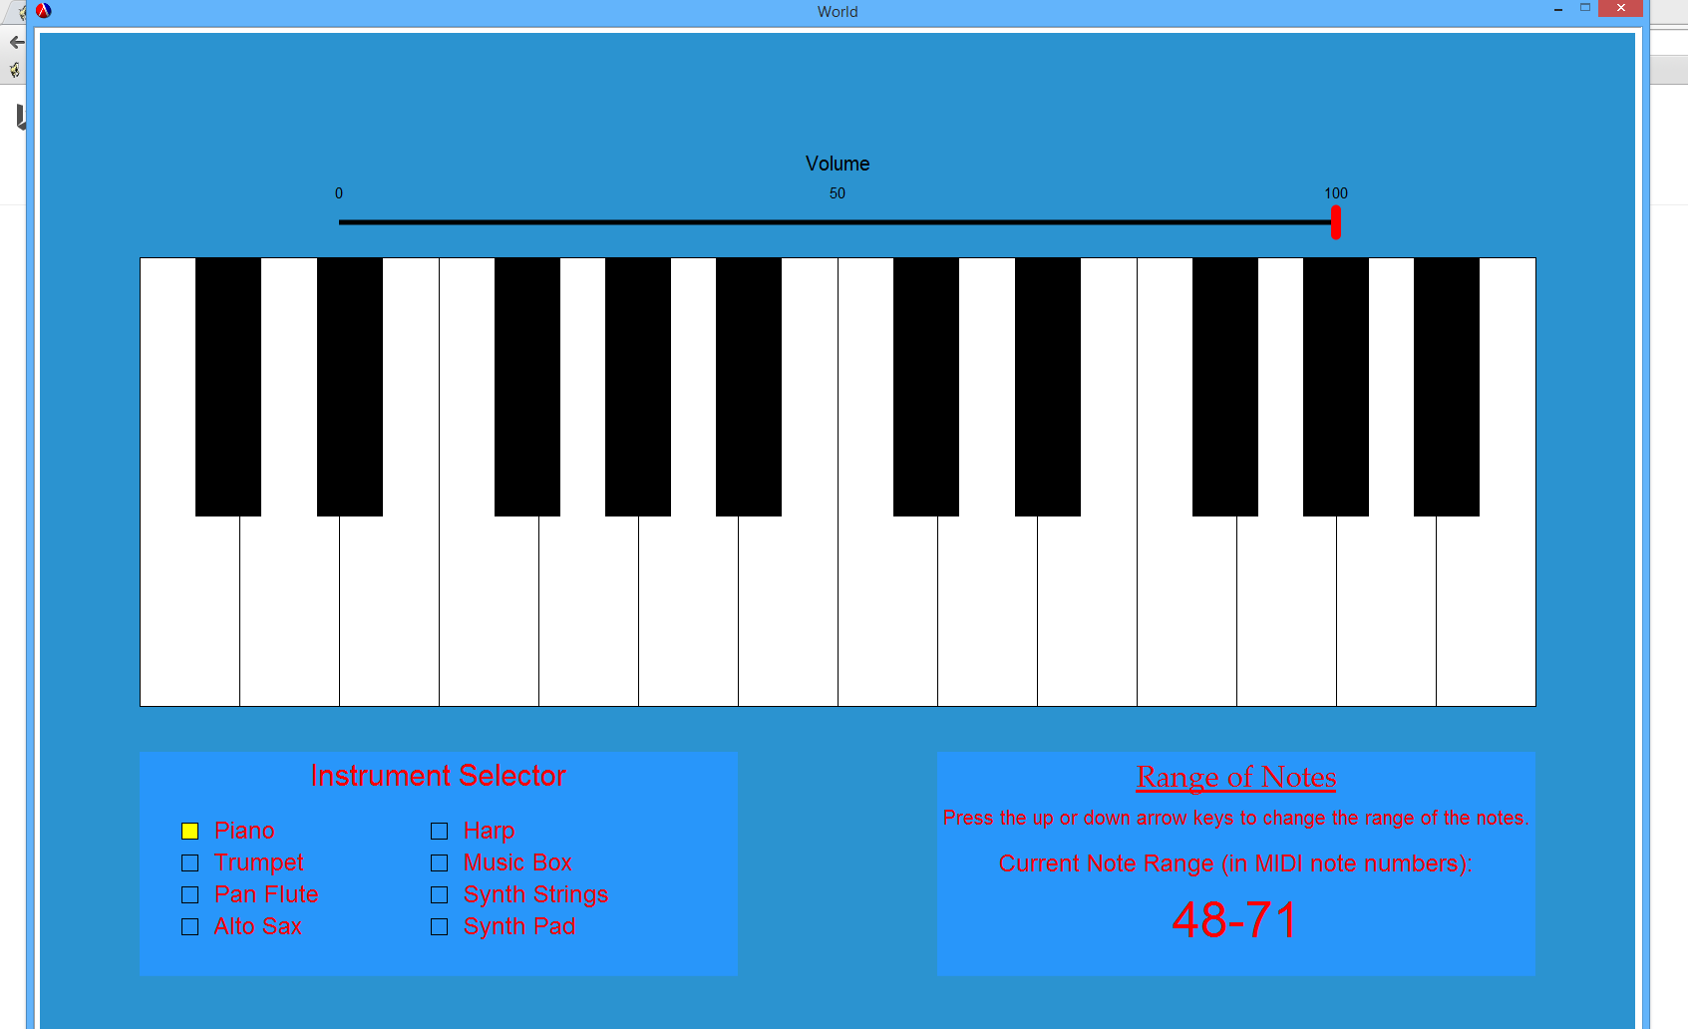

Slide 4
Extending the idea

Slide 6
QUESTIONS?

